Slide 1
MAS508-G Control Theory
Lecture 3: State Space Design Summary
Prof. Jing Zhou
University of Agder
Department of Engineering Sciences
Notes:
© Copyright 2021 Jing Zhou @UiA

Slide 2
L3. State Space Design
Time Response
Controllability
Observability
Pole Placement Control
Observer Design
Output Feedback Control
Optimal Control - Linear Quadratic Control (LQR)
Optimal Control – LQG
Textbook, “Control Systems Engineering”, Chapters 4 &12

Slide 3










State Feedback
$$\dot{x}=Ax+Bu$$
$$r$$
+
+
-
+
Notes:
For control design, we will assume that the full state is measured.

Slide 4
Summary of State Space
State Space Model
Time Response
Controllability
State Feedback Control
  Pole Placement Design
  Optimal Control - Linear Quadratic Regulator (LQR)
Reference Tracking using Prefilter and Integrator
Observability
Observer Design
Output Feedback Control

Slide 5
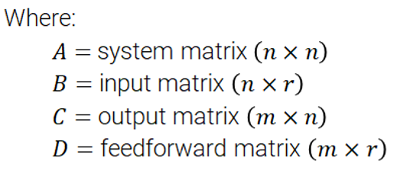
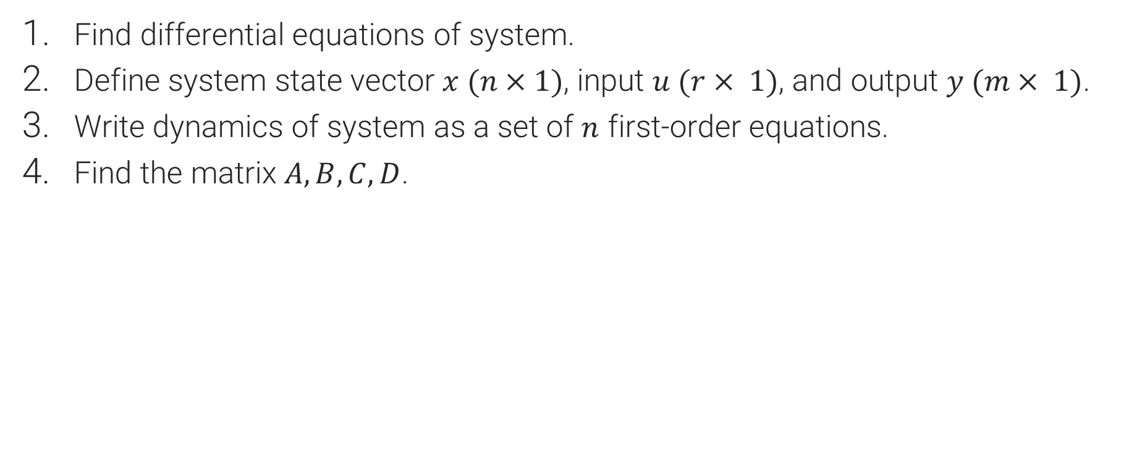
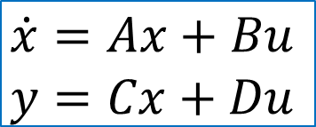
1) State-Space Model
Find differential equations of system.
Define system state vector $x (n×1)$, input $u (r× 1)$, and output $y (m× 1)$.
Write dynamics of system as a set of $n$ first-order equations.
Find the matrix $A, B, C, D$.
$$\dot{x}=Ax+Bu$$
$$y=Cx+Du$$

Slide 6
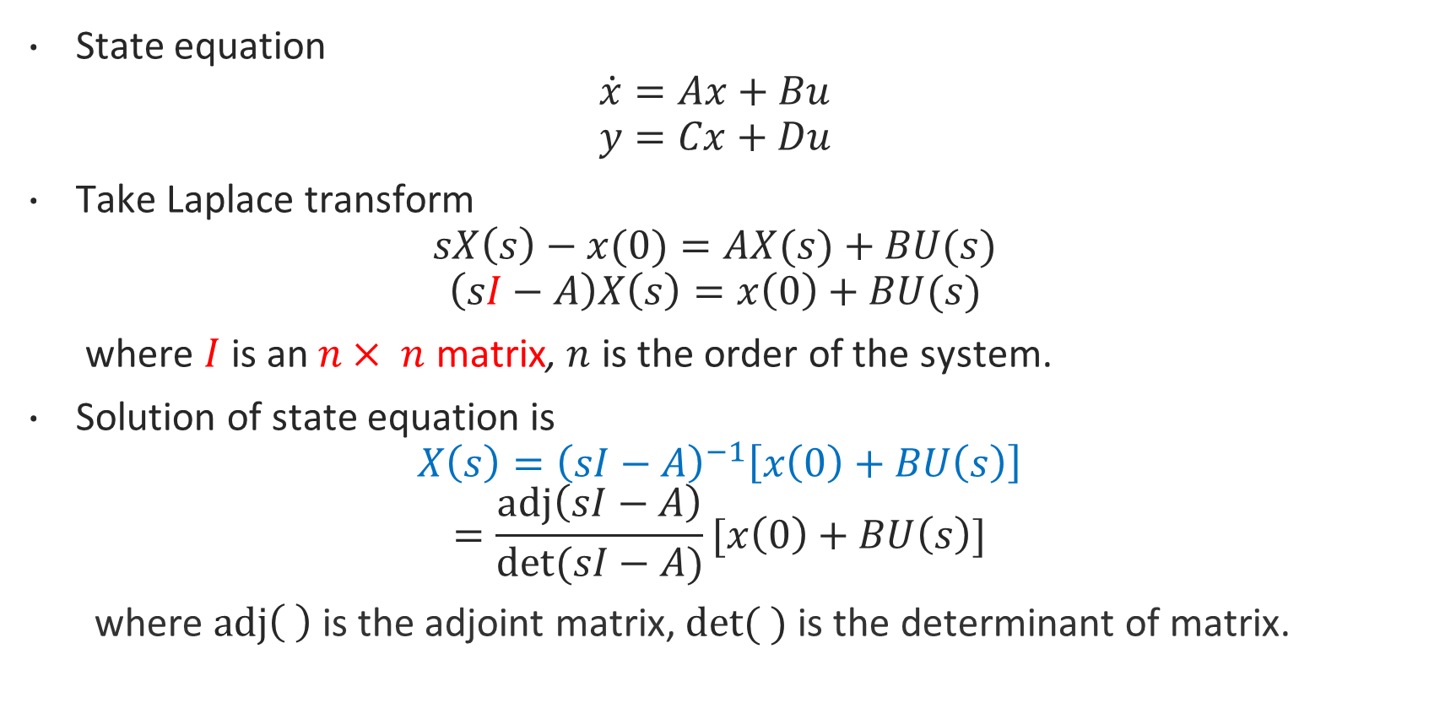
2) Time response
State equation
$$\dot{x}=Ax+Bu$$
$$y=Cx+Du$$
Take Laplace transform
$$sX\left(s\right)−x(0)=AX(s)+BU(s)$$
$$\left(sI−A\right)X\left(s\right)=x\left(0\right)+BU(s)$$
where $I$is an $n× n$ matrix, $n$ is the order of the system.
Solution of state equation is
$$X\left(s\right)={\left(sI−A\right)}^{−1}\left[x\left(0\right)+BU\left(s\right)\right]$$
$$=\frac{adj\left(sI−A\right)}{det⁡(sI−A)}[x\left(0\right)+BU\left(s\right)]$$
where $adj\left( \right)$is the adjoint matrix, $det( )$is the determinant of matrix.

Slide 7
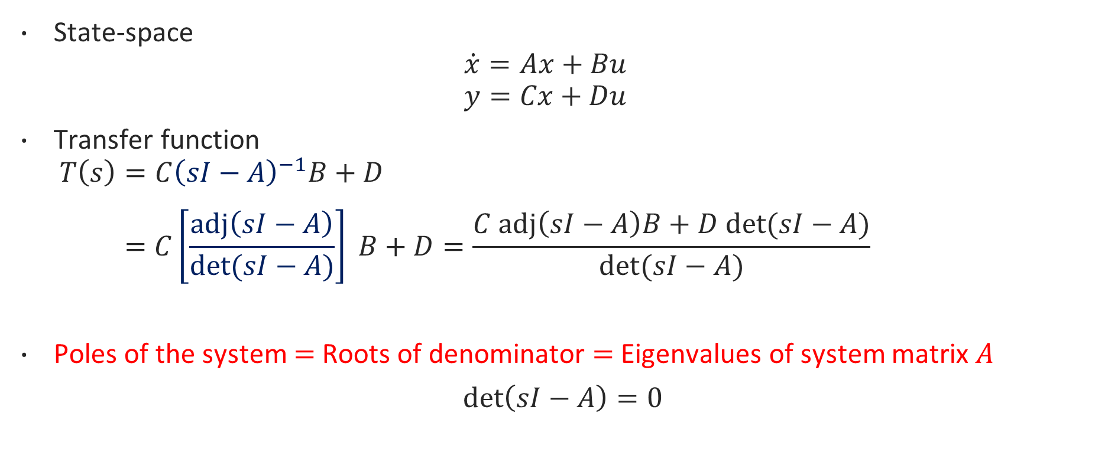
2) Eigenvalues and transfer function poles
State-space
$$\dot{x}=Ax+Bu$$
$$y=Cx+Du$$
Transfer function
$$T\left(s\right)=C{\left(sI−A\right)}^{−1}B+D$$
$$=C\left[\frac{adj\left(sI−A\right)}{det⁡(sI−A)}\right] B+D=\frac{C adj\left(sI−A\right)B+D det⁡(sI−A)}{det⁡(sI−A)}$$
Poles of the system $=$ Roots of denominator $=$ Eigenvalues of system matrix $A$
$\det\left(sI−A\right)=0$

Slide 8
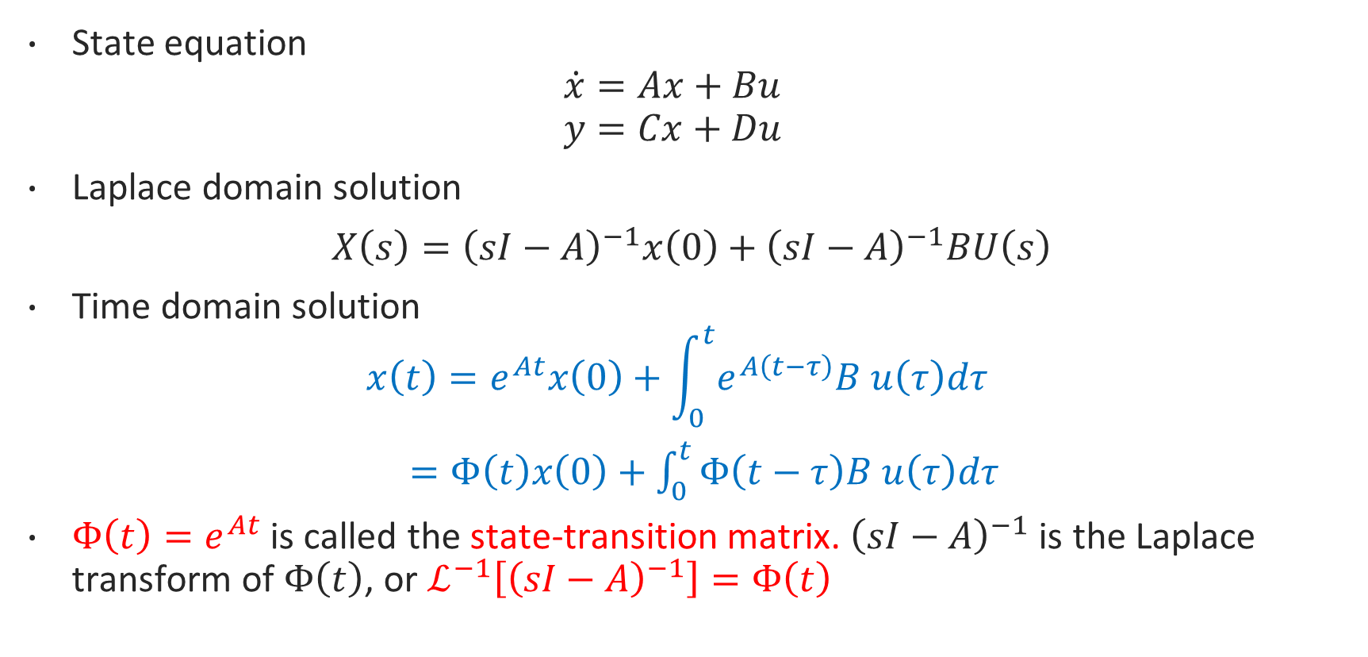
2) Time response
State equation
$$\dot{x}=Ax+Bu$$
$$y=Cx+Du$$
Laplace domain solution
$X\left(s\right)={\left(sI−A\right)}^{−1}x\left(0\right)+{\left(sI−A\right)}^{−1}BU\left(s\right)$
Time domain solution
$$x\left(t\right)=e^{At}x\left(0\right)+\int_{0}^{t}{e^{A\left(t−τ\right)}B u\left(τ\right)dτ}$$
$=Φ\left(t\right)x\left(0\right)+\int_{0}^{t}{Φ\left(t−τ\right)B u\left(τ\right)dτ}$
$Φ\left(t\right)=e^{At}$ is called the state-transition matrix. ${\left(sI−A\right)}^{−1}$ is the Laplace transform of $Φ\left(t\right)$, or $ℒ^{−1}\left[{\left(sI−A\right)}^{−1}\right]=Φ\left(t\right)$

Slide 9
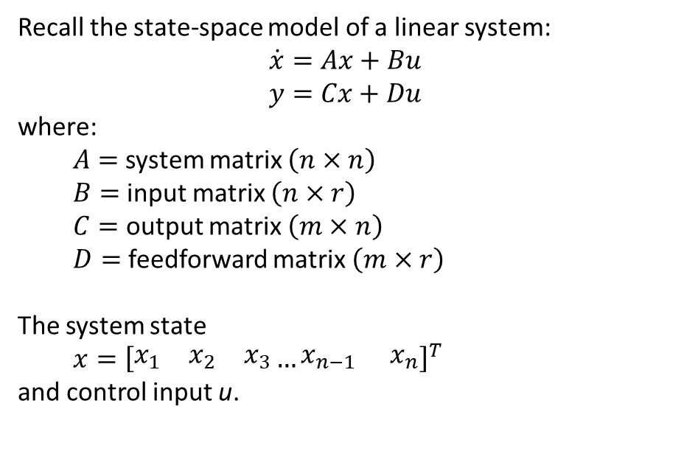
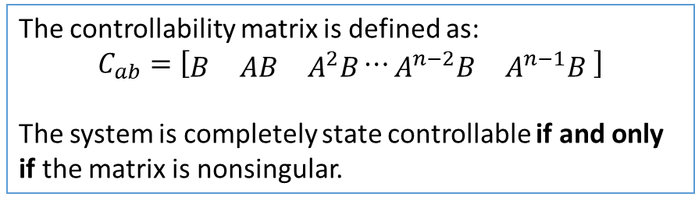


3) Controllability
for square matrix

Slide 10
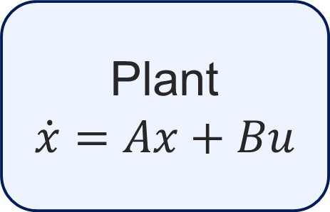
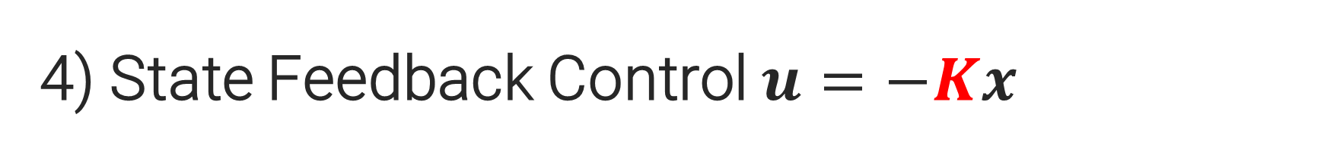

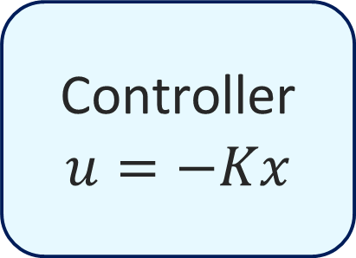
4) State Feedback Control $u=−Kx$
Controller
$$u=−Kx$$
Plant
$$\dot{x}=Ax+Bu$$
$$x$$

Slide 11

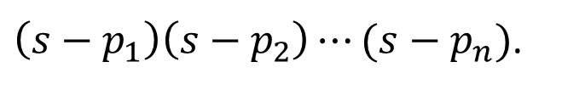
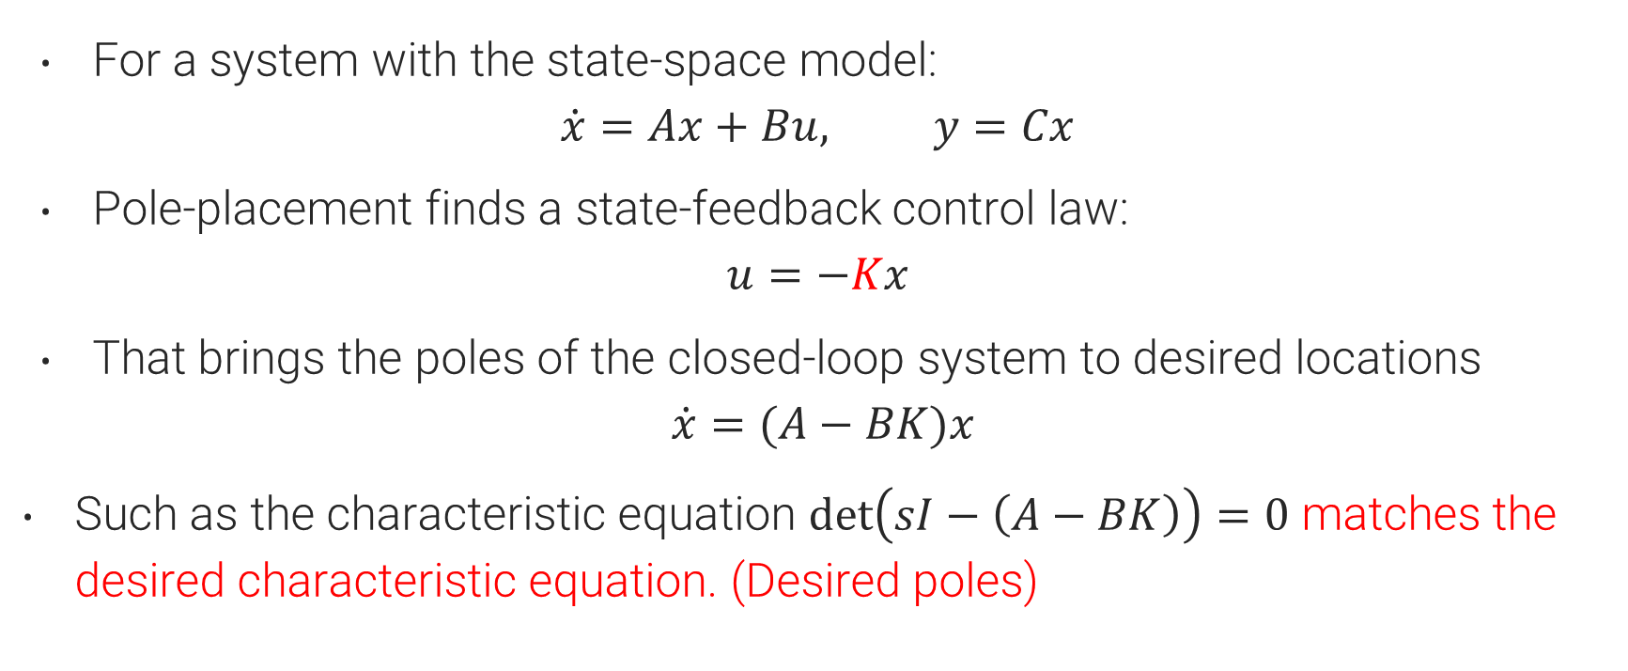
4) Pole Placement Design to Find $K$
For a system with the state-space model:
$$\dot{x}=Ax+Bu, y=Cx$$
Pole-placement finds a state-feedback control law:
$$u=−Kx$$
That brings the poles of the closed-loop system to desired locations
$$\dot{x}=(A−BK)x$$
Such as the characteristic equation $\det\left(sI−\left(A−BK\right)\right)=0$ matches the desired characteristic equation. (Desired poles)
$\left(s−p_{1}\right)\left(s−p_{2}\right)⋯(s−p_{n})$.

Slide 12
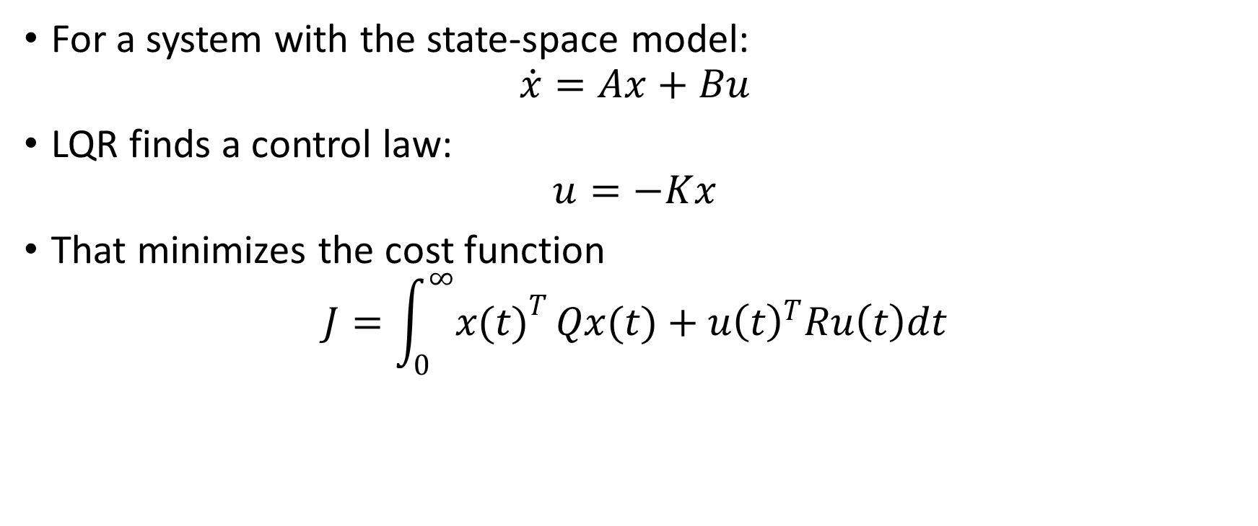

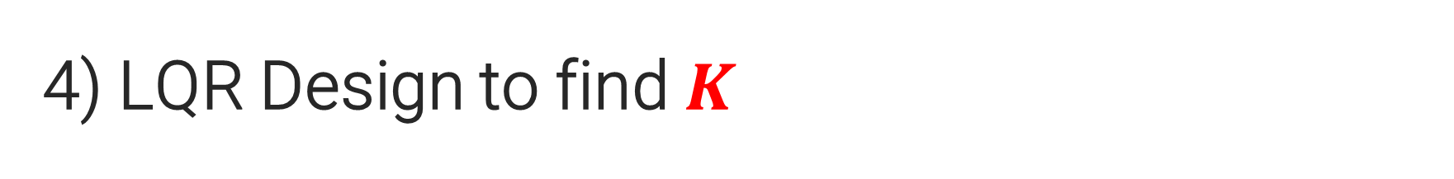


4) LQR Design to find $K$
$Q≥0, R≥0$ are positive definite matrices.
Find $P$ that solves the Algebraic Riccati Equation.
Find the optimal control gain $K$.
$$A^{T}P+PA+Q−PBR^{−1}B^{T}P=0$$
$$K=R^{−1}B^{T}P$$

Slide 13







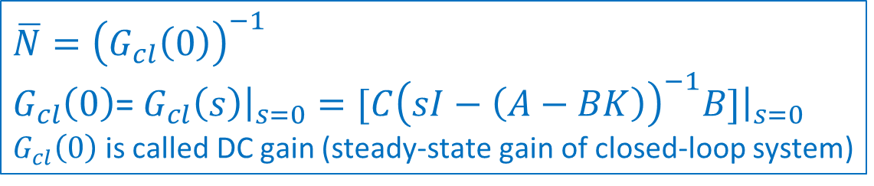
5) Tracking using Pre-filter
$$\overline{N}$$
+
+
-
+
$$\overline{N}={\left(G_{cl}\left(0\right)\right)}^{−1}$$
$G_{cl}\left(0\right)$= $G_{cl}\left(s\right){\left.​\right|}_{s=0}=[C{\left(sI−\left(A−BK\right)\right)}^{−1}B]{\left.​\right|}_{s=0}$
$G_{cl}\left(0\right)$is called DC gain (steady-state gain of closed-loop system)

Slide 14
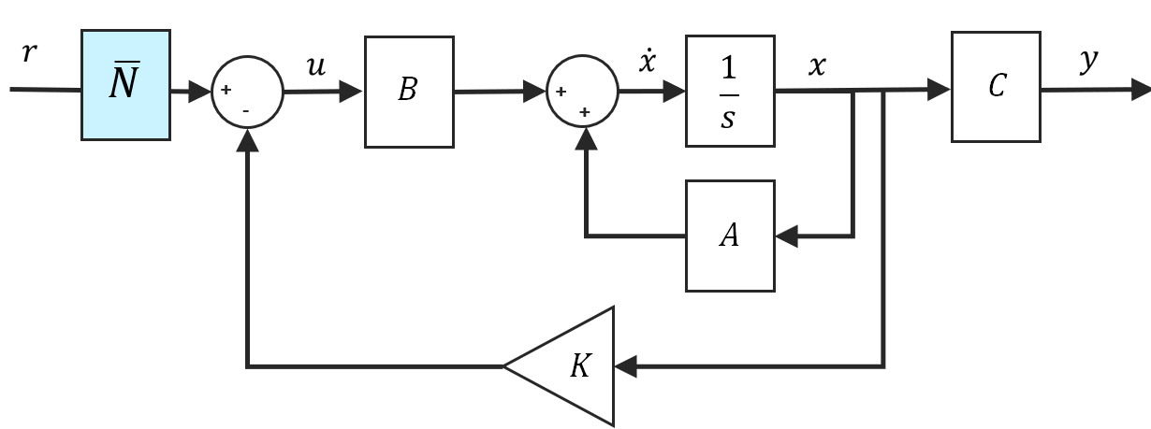
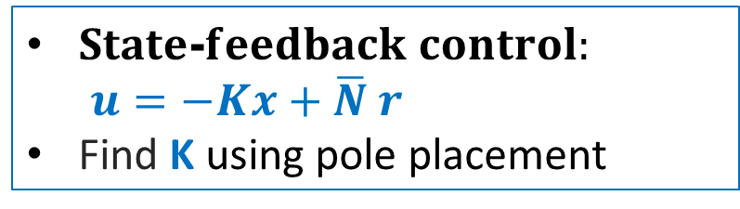
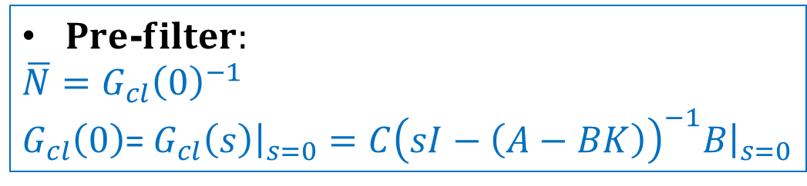
Pre-filter
Control objective: 1) Desired poles (stability, transient performance)
2) $Tracking error=0, lim_{\left\{t→∞\right\}} y(t)=r.$
$State$-$feedback control:$
$u=−Kx+\overline{N} r$
Find K using pole placement
$Pre$-$filter:$
$$\overline{N}=G_{cl}{\left(0\right)}^{−1}$$
$G_{cl}\left(0\right)$= $G_{cl}\left(s\right){\left.​\right|}_{s=0}=C{\left(sI−\left(A−BK\right)\right)}^{−1}B{\left.​\right|}_{s=0}$

Slide 15





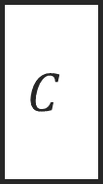

5) Tracking using Integral Control
$$e$$
$$∫$$
$$x_{N}$$
$$K_{e}$$
$$B$$
$$C$$
+
+
+
-
-
+
$K$

Slide 16
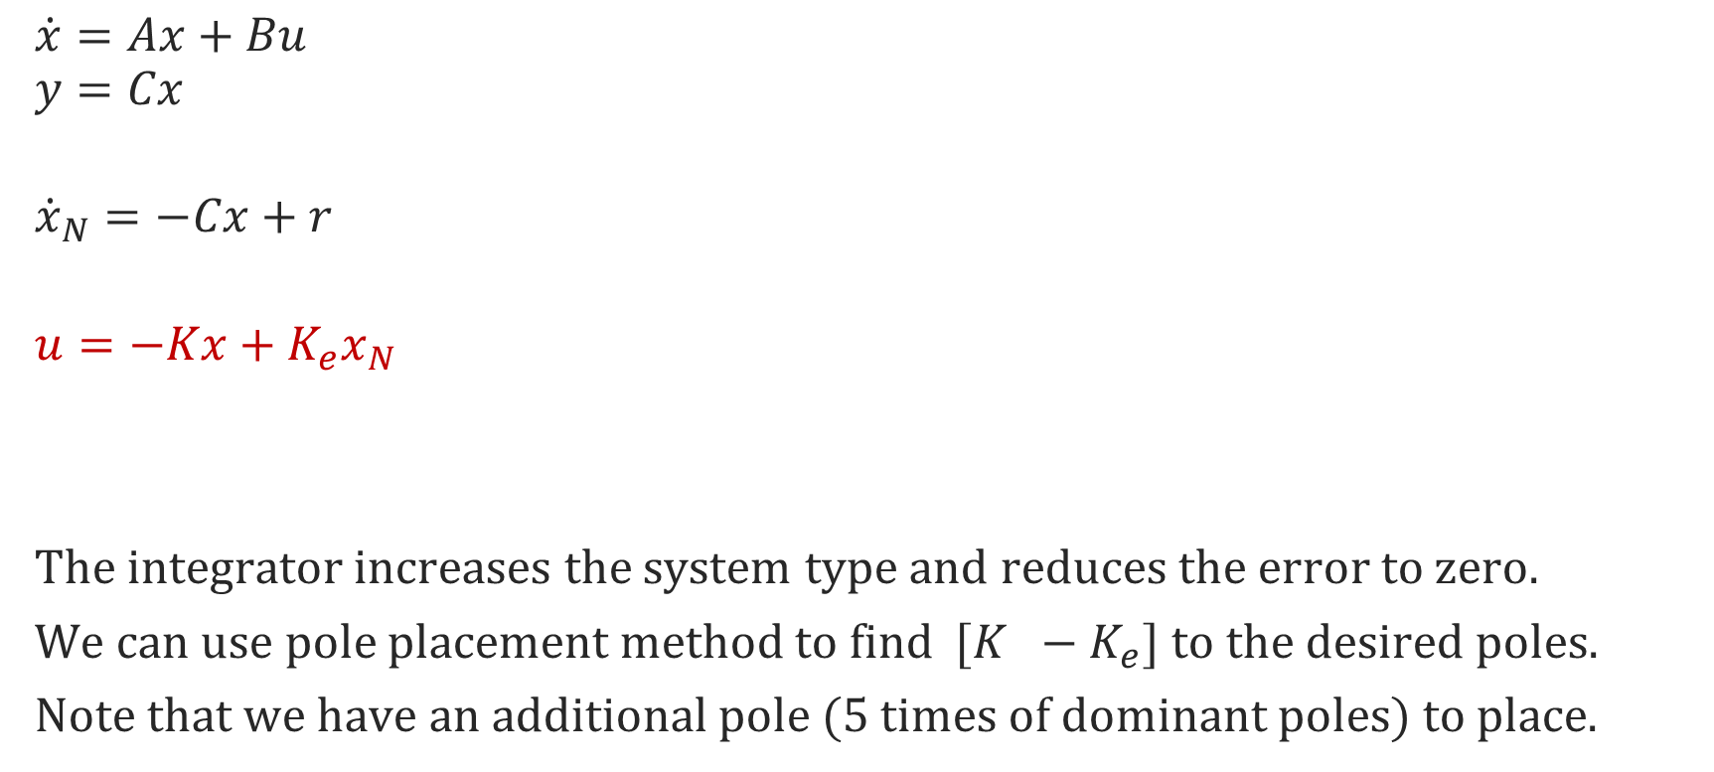
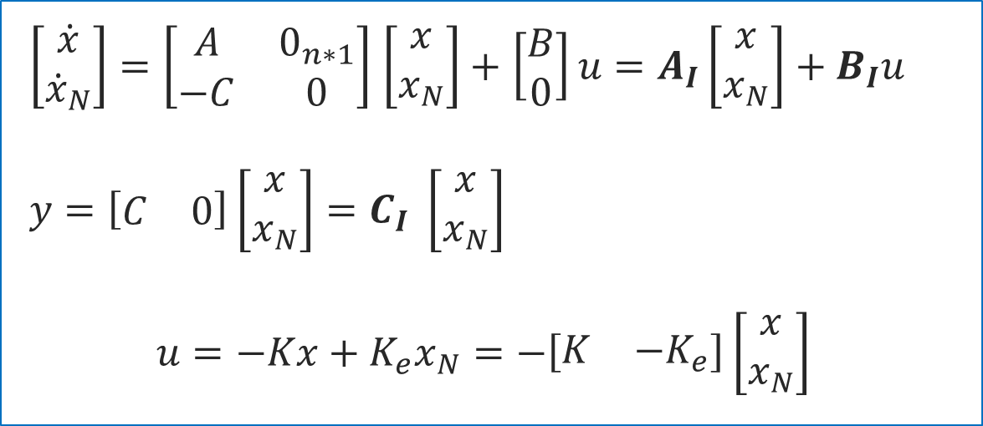
Integral Control
$\left[\begin{matrix}\dot{x} \\ {\dot{x}}_{N}\end{matrix}\right]=\left[\begin{matrix}A & 0_{n∗1} \\ −C & 0\end{matrix}\right]$ $\left[\begin{matrix}x \\ x_{N}\end{matrix}\right]+$ $\left[\begin{matrix}B \\ 0\end{matrix}\right]u=A_{I}\left[\begin{matrix}x \\ x_{N}\end{matrix}\right]+B_{I}u$
$$y=\left[\begin{matrix}C & 0\end{matrix}\right]\left[\begin{matrix}x \\ x_{N}\end{matrix}\right]=C_{I} \left[\begin{matrix}x \\ x_{N}\end{matrix}\right]$$
$$u=−Kx+K_{e}x_{N}=−\left[\begin{matrix}K & {−K}_{e}\end{matrix}\right]\left[\begin{matrix}x \\ x_{N}\end{matrix}\right]$$
$$\dot{x}=Ax+Bu$$
$$y=Cx$$
$${\dot{x}}_{N}=−Cx+r$$
$$u=−Kx+K_{e}x_{N}$$
The integrator increases the system type and reduces the error to zero.
We can use pole placement method to find $[K −K_{e}]$ to the desired poles.
Note that we have an additional pole (5 times of dominant poles) to place.

Slide 17
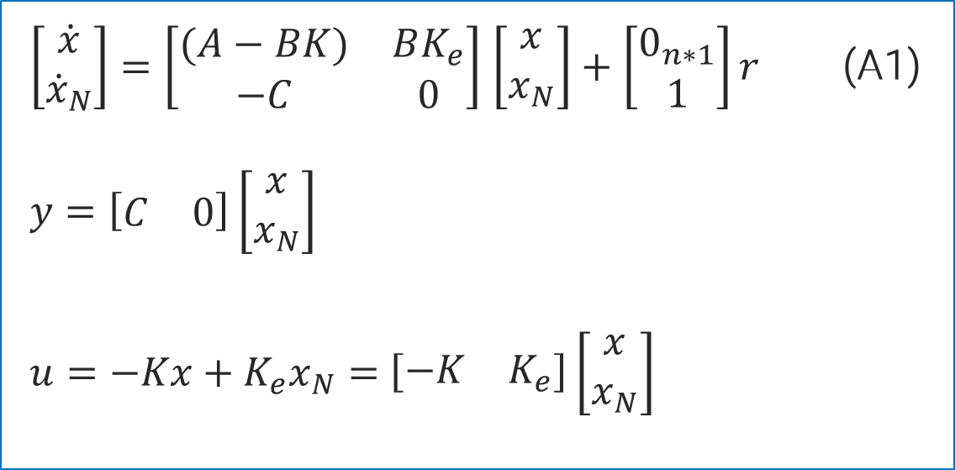
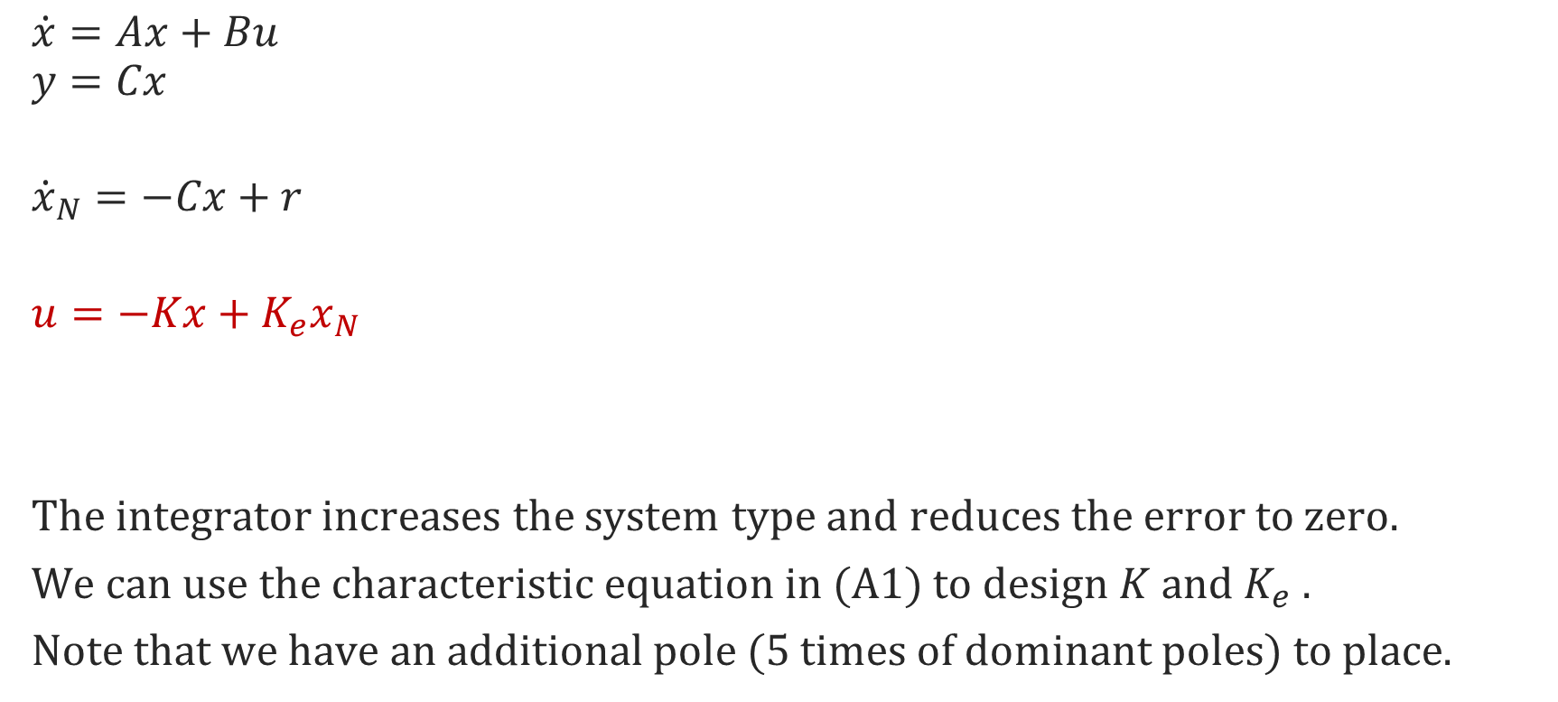
Integral Control
$\left[\begin{matrix}\dot{x} \\ {\dot{x}}_{N}\end{matrix}\right]=\left[\begin{matrix}(A−BK) & BK_{e} \\ −C & 0\end{matrix}\right]$ $\left[\begin{matrix}x \\ x_{N}\end{matrix}\right]+$ $\left[\begin{matrix}0_{n∗1} \\ 1\end{matrix}\right]r$ (A1)
$$y=\left[\begin{matrix}C & 0\end{matrix}\right]\left[\begin{matrix}x \\ x_{N}\end{matrix}\right]$$
$u=−Kx+K_{e}x_{N}=$ $\left[\begin{matrix}−K & K_{e}\end{matrix}\right]\left[\begin{matrix}x \\ x_{N}\end{matrix}\right]$
$$\dot{x}=Ax+Bu$$
$$y=Cx$$
$${\dot{x}}_{N}=−Cx+r$$
$$u=−Kx+K_{e}x_{N}$$
The integrator increases the system type and reduces the error to zero.
We can use the characteristic equation in (A1) to design $K$ and $K_{e}$ .
Note that we have an additional pole (5 times of dominant poles) to place.

Slide 18
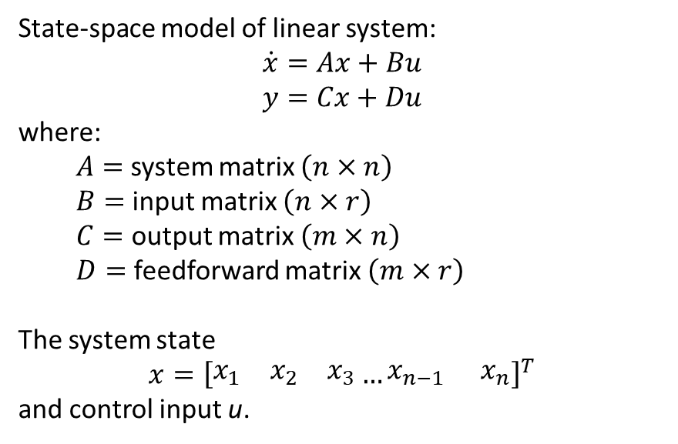
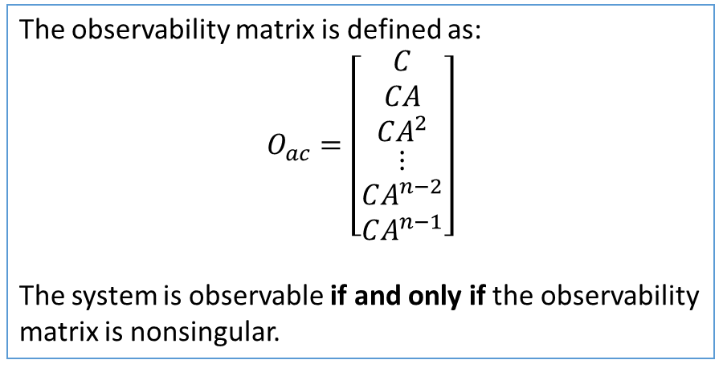
6) Observability

Slide 19
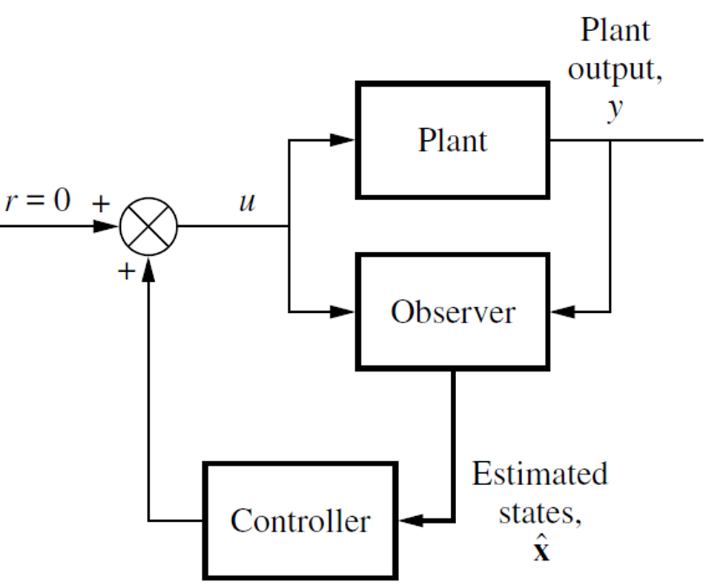

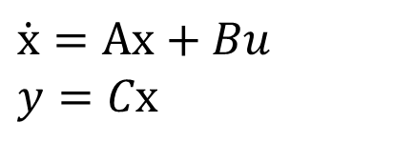

7) Closed-loop Observer
$$\dot{x}=Ax+Bu \\ y=Cx$$
Closed-loop observer is described by
$$\dot{\hat{x}}=\left(A−LC\right)\hat{x}+Bu+Ly$$
It can be constructed with arbitrary eigenvalues
if and only if the system ($A, C$) is observable.

Slide 20
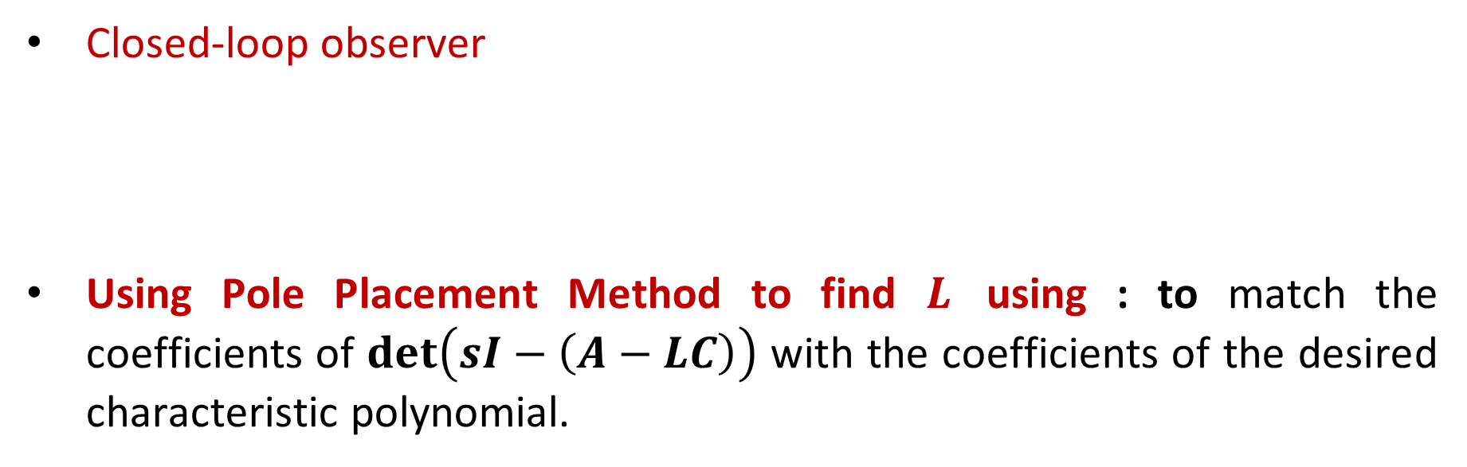
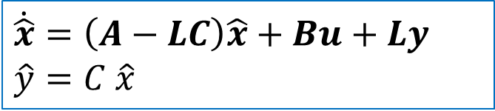
7) Observer: Pole Placement method
$$\dot{x}=Ax+Bu \\ y=Cx$$
Closed-loop observer
Using Pole Placement Method to find $L$ using : to match the coefficients of $\det\left(sI−\left(A−LC\right)\right)$ with the coefficients of the desired characteristic polynomial.
$$\dot{\hat{x}}=\left(A−LC\right)\hat{x}+Bu+Ly$$
$$\hat{y}=C \hat{x}$$

Slide 21
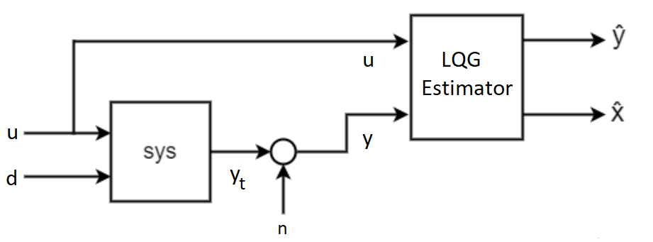
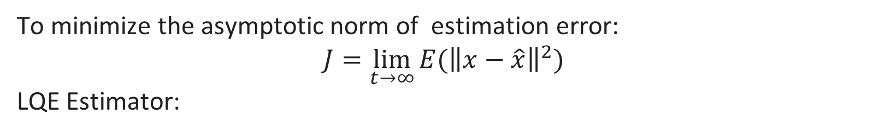
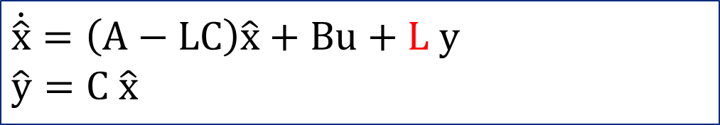
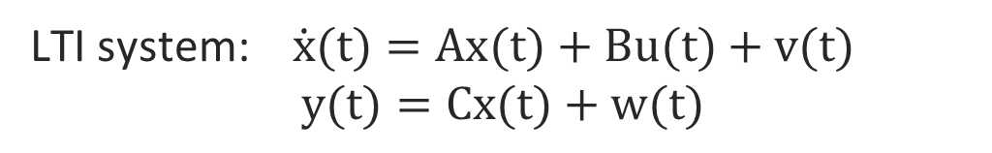

7) Observer: Linear-Quadratic Estimator (LQE)
LTI system: $\dot{x}(t)=Ax(t)+Bu(t)+v(t)$
$y(t)=Cx(t)+w(t)$
To minimize the asymptotic norm of estimation error:
$$J=\lim_{t→∞}{E({\left\|x−\hat{x}\right\|}^{2})}$$
LQE Estimator:
$$\dot{\hat{x}}=\left(A−LC\right)\hat{x}+Bu+L y$$
$$\hat{y}=C \hat{x}$$
LQE
Estimator
$y_{t}$ is the plant true output and does not include the measurement noise.
Disturbance
Noise

Slide 22
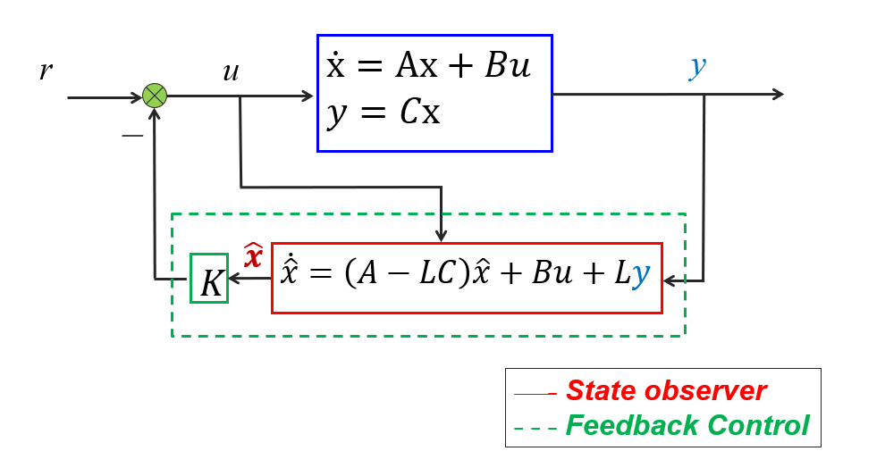
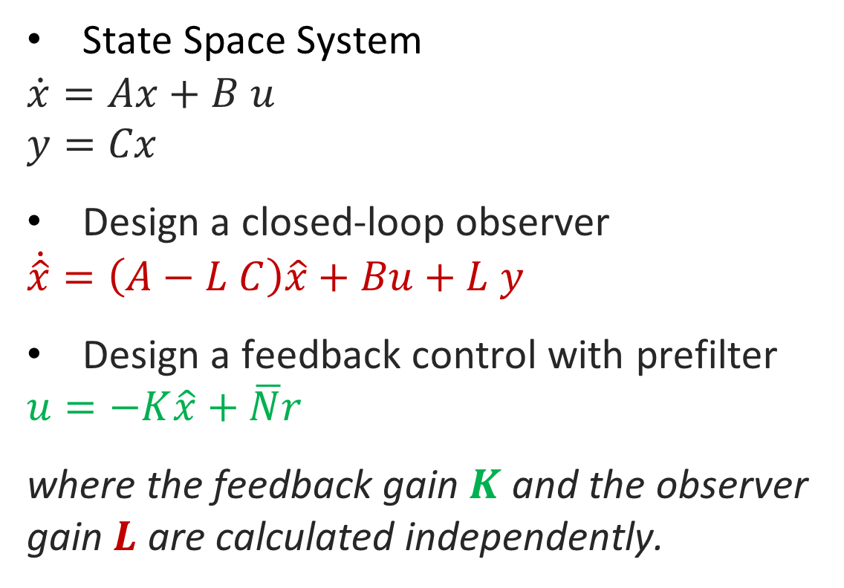

8) Output Feedback Control
State Space System
$$\dot{x}=Ax+B u$$
$$y=Cx$$
Design a closed-loop observer
$$\dot{\hat{x}}=\left(A−L C\right)\hat{x}+Bu+L y$$
Design a feedback control with prefilter
$$u=−K\hat{x}+\overline{N}r$$
where the feedback gain $K$ and the observer gain $L$ are calculated independently.
$$\overline{N}$$

Slide 23
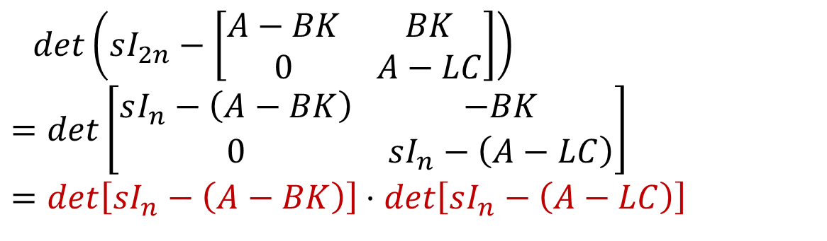
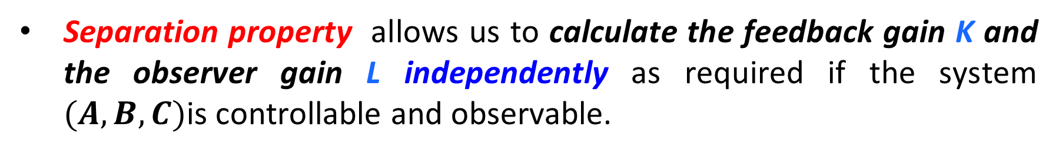
Compute the characteristic polynomial of output feedback system ${\left[\begin{aligned}x \\ \tilde{x}\end{aligned}\right]}^{T}=$ $\left[\begin{aligned}x \\ x−\hat{x}\end{aligned}\right]$
$$\left[\begin{matrix}\dot{x} \\ \dot{\tilde{x}}\end{matrix}\right]=\left[\begin{matrix}A−BK & BK \\ 0 & A−LC\end{matrix}\right]\left[\begin{matrix}x \\ \tilde{x}\end{matrix}\right]+\left[\begin{matrix}B \\ 0\end{matrix}\right]r , y=\left[C\begin{matrix} & 0\end{matrix}\right]\left[\begin{matrix}x \\ \tilde{x}\end{matrix}\right]$$
$$\det\left(sI_{2n}−\left[\begin{matrix}A−BK & BK \\ 0 & A−LC\end{matrix}\right]\right) \\ =\det\left[\begin{matrix}sI_{n}−\left(A−BK\right) & −BK \\ 0 & sI_{n}−\left(A−LC\right)\end{matrix}\right] \\ =\det\left[sI_{n}−\left(A−BK\right)\right]⋅\det\left[sI_{n}−\left(A−LC\right)\right]$$
Separation property allows us to calculate the feedback gain K and the observer gain L independently as required if the system $(A,B,C)$is controllable and observable.

Slide 24









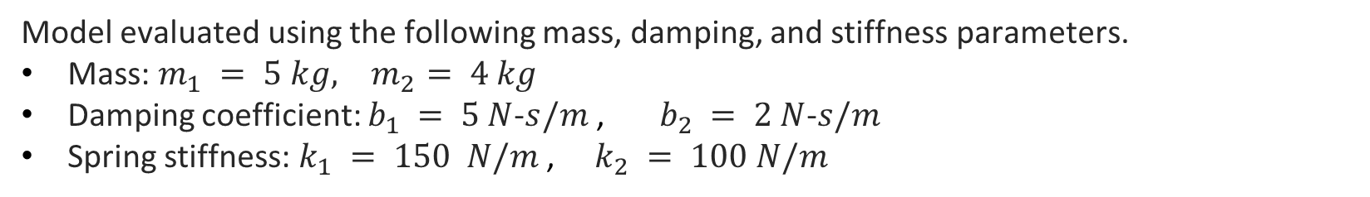
Example: Mass-Spring-Damper System
$$q_{1}\left(t\right)$$
$$q_{2}\left(t\right)$$
Mass 1
Mass 2
$$f\left(t\right)$$
Consider a mechanical system with two degrees of freedom of movement, where the displacements $q_{1}\left(t\right), q_{2}(t)$ are the outputs, the external force $f(t)$ is the input.
Model evaluated using the following mass, damping, and stiffness parameters.
Mass: $m_{1} = 5 kg, { m}_{2} = 4 kg$
Damping coefficient: $b_{1} = 5 N$-$s/m$ , $b_{2} = 2 N$-$s/m$
Spring stiffness: $k_{1} = 150 N/m$ , $k_{2} = 100 N/m$
Notes:
Structures can be modeled as mass-spring-damper systems. In this case, a two-story structure is modeled as a 2 DOF mass-spring-damper system.

Slide 25
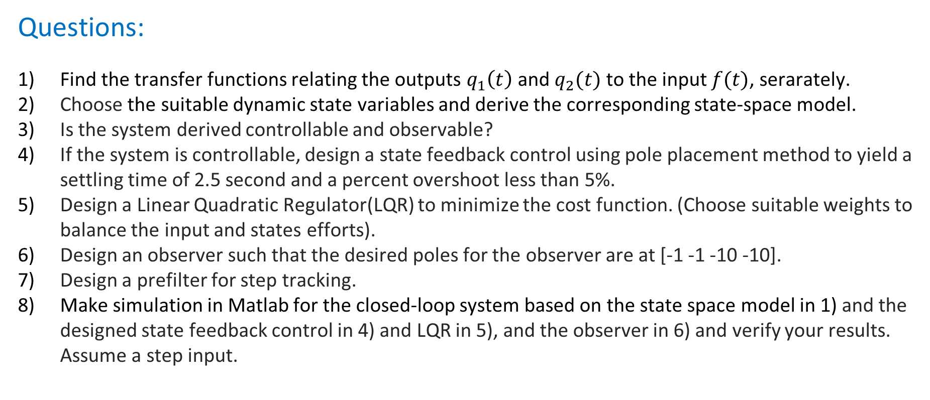
Example A: Mass-Spring-Damper System
choose two parameters,
Questions:
Find the transfer functions relating the outputs $q_{1}\left(t\right)$ and $q_{2}(t)$ to the input $f(t)$, serarately.
Choose the suitable dynamic state variables and derive the corresponding state-space model.
Is the system derived controllable and observable?
If the system is controllable, design a state feedback control using pole placement method to yield a settling time of 2.5 second and a percent overshoot less than 5%.
Design a Linear Quadratic Regulator(LQR) to minimize the cost function. (Choose suitable weights to balance the input and states efforts).
Design an observer such that the desired poles for the observer are at [-1 -1 -10 -10].
Design a prefilter for step tracking.
Make simulation in Matlab for the closed-loop system based on the state space model in 1) and the designed state feedback control in 4) and LQR in 5), and the observer in 6) and verify your results. Assume a step input.

Slide 26
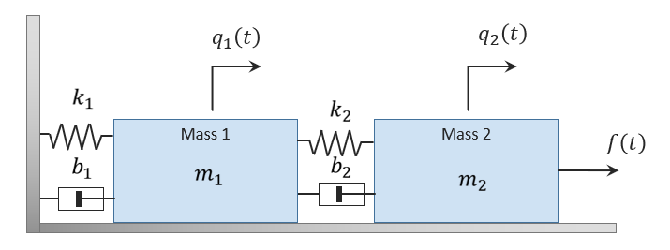
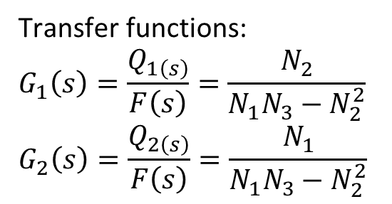
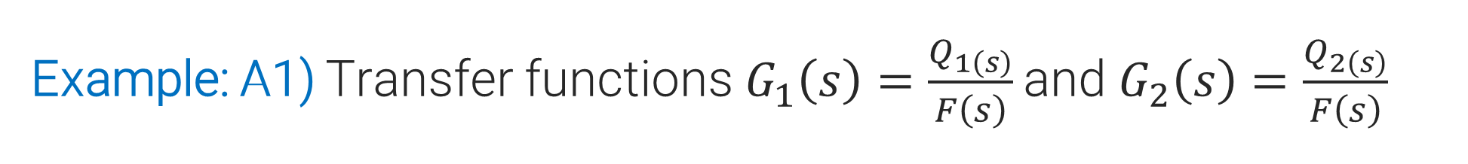
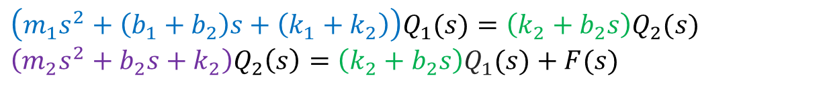
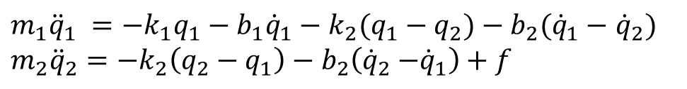
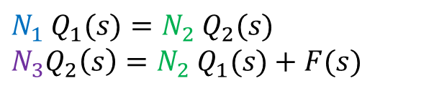
Example: A1) Transfer functions$G_{1}\left(s\right)=\frac{Q_{1\left(s\right)}}{F\left(s\right)}$ and $G_{2}\left(s\right)=\frac{Q_{2\left(s\right)}}{F\left(s\right)}$
$$N_{1} Q_{1}(s)=N_{2}{ Q}_{2}(s)$$
$$N_{3}Q_{2}\left(s\right)=N_{2} Q_{1}(s)+F(s)$$
Using Newton 2nd law to derive the equations of motion for two masses:
Transfer functions:
$$G_{1}\left(s\right)=\frac{Q_{1\left(s\right)}}{F\left(s\right)}=\frac{N_{2}}{N_{1}N_{3}−N_{2}^{2}}$$
$$G_{2}\left(s\right)=\frac{Q_{2\left(s\right)}}{F\left(s\right)}=\frac{N_{1}}{N_{1}N_{3}−N_{2}^{2}}$$
${m_{1}\ddot{q}}_{1} =−k_{1}q_{1}−b_{1}{\dot{q}}_{1}−k_{2}(q_{1}−q_{2})−b_{2}({\dot{q}}_{1}−$ ${\dot{q}}_{2})$
$${m_{2}\ddot{q}}_{2}=−k_{2}\left(q_{2}−q_{1}\right)−b_{2}\left({\dot{q}}_{2}{−\dot{q}}_{1}\right)+f$$
T$ake the Laplace transform:$
$$\left(m_{1}s^{2}+\left(b_{1}+b_{2}\right)s+\left(k_{1}+k_{2}\right)\right)Q_{1}(s)=\left(k_{2}+b_{2}s\right)Q_{2}(s)$$
$$\left(m_{2}s^{2}+b_{2}s+k_{2}\right)Q_{2}\left(s\right)=\left(k_{2}+b_{2}s\right)Q_{1}(s)+F(s)$$

Slide 27
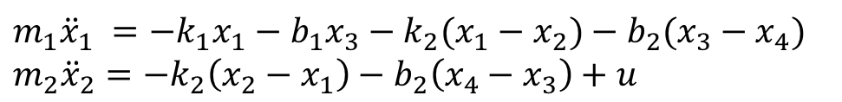
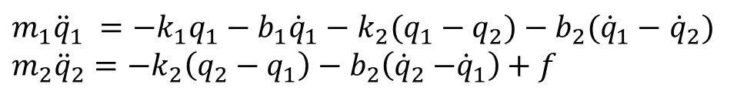
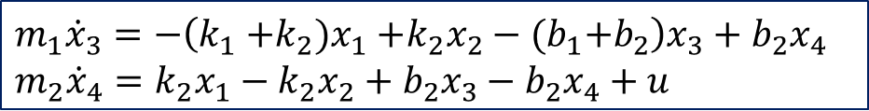
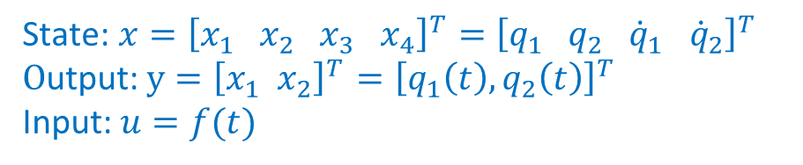

Example: A2) State-Space Model
Choose the state variables $x={\left[q_{1} q_{2} {\dot{q}}_{1} {\dot{q}}_{2}\right]}^{T}$, the output $y={\left[q_{1}\left(t\right), q_{2}\left(t\right)\right]}^{T}$, and the control input $u=f\left(t\right):$
$${m_{1}\ddot{x}}_{1} =−k_{1}x_{1}−b_{1}x_{3}−k_{2}(x_{1}−x_{2})−b_{2}(x_{3}−x_{4})$$
$${m_{2}\ddot{x}}_{2}=−k_{2}\left(x_{2}−x_{1}\right)−b_{2}\left(x_{4}−x_{3}\right)+u$$
Collecting the coefficients:
Using Newton 2nd law to derive the equations of motion for two masses:
$$m_{1}{\dot{x}}_{3}=−\left(k_{1}{+k_{2})x}_{1}+k_{2}x_{2}−{(b}_{1}+b_{2}\right)x_{3}+b_{2}x_{4}$$
$$m_{2}{\dot{x}}_{4}=k_{2}x_{1}−k_{2}x_{2}+b_{2}x_{3}−b_{2}x_{4}+u$$
${m_{1}\ddot{q}}_{1} =−k_{1}q_{1}−b_{1}{\dot{q}}_{1}−k_{2}(q_{1}−q_{2})−b_{2}({\dot{q}}_{1}−$ ${\dot{q}}_{2})$
$${m_{2}\ddot{q}}_{2}=−k_{2}\left(q_{2}−q_{1}\right)−b_{2}\left({\dot{q}}_{2}{−\dot{q}}_{1}\right)+f$$
State: $x={\left[x_{1} x_{2} x_{3} x_{4}\right]}^{T}={\left[q_{1} q_{2} {\dot{q}}_{1} {\dot{q}}_{2}\right]}^{T}$
$O$utput: $y={\left[x_{1} x_{2}\right]}^{T}$ $={\left[q_{1}\left(t\right), q_{2}\left(t\right)\right]}^{T}$
Input: $u=f(t)$

Slide 28








Example: A2) State-Space Model
Equations of states:
$${\dot{x}}_{1}=x_{3}$$
$${\dot{x}}_{2}=x_{4}$$
$${\dot{x}}_{3}=\frac{1}{m_{1}}\left(−\left(k_{1}{+k_{2})x}_{1}+k_{2}x_{2}−{(b}_{1}+b_{2}\right)x_{3}+b_{2}x_{4}\right)$$
$${\dot{x}}_{4}=\frac{1}{m_{2}}\left(k_{2}x_{1}−k_{2}x_{2}+b_{2}x_{3}−b_{2}x_{4}+u\right)$$
State: $x={\left[x_{1} x_{2} x_{3} x_{4}\right]}^{T}={\left[q_{1} q_{2} {\dot{q}}_{1} {\dot{q}}_{2}\right]}^{T}$
$O$utput: $y={\left[x_{1} x_{2}\right]}^{T}$ $={\left[q_{1}\left(t\right), q_{2}\left(t\right)\right]}^{T}$
Input: $u=f(t)$
$C=\left[\begin{matrix}1 & 0 \\ 0 & 1\end{matrix} \begin{matrix}0 & 0 \\ 0 & 0\end{matrix}\right]$
$D=\left[\begin{matrix}0 \\ 0\end{matrix}\right]$

Slide 29





Example: A2) State-Space Model
$x={\left[q_{1} q_{2} {\dot{q}}_{1} {\dot{q}}_{2}\right]}^{T}$
$y={\left[q_{1}\left(t\right), q_{2}\left(t\right)\right]}^{T}$
$u=f\left(t\right)$
$C=\left[\begin{matrix}1 & 0 \\ 0 & 1\end{matrix} \begin{matrix}0 & 0 \\ 0 & 0\end{matrix}\right]$
$D=\left[\begin{matrix}0 \\ 0\end{matrix}\right]$
$m_{1} = 5 kg, { m}_{2} = 4 kg$
$b_{1} = 5 N$-$s/m$ , $b_{2} = 2 N$-$s/m$
$k_{1} = 150 N/m$ , $k_{2} = 100 N/m$

Slide 30




Example: A3) Is it controllable and observable?
Controllability Matrix
Observability Matrix
Yes - system is controllable
We can design a state-feedback control assuming full state is available.
Yes - system is observable.
We can design an observer to estimate the state using the measured variables.
$$C=\left[\begin{matrix}1 & 0 \\ 0 & 1\end{matrix} \begin{matrix}0 & 0 \\ 0 & 0\end{matrix}\right]$$

Slide 31

Example: A4) Pole-Placement Control
step1) Calculate the desired poles from the control specifications
Using characteristic equations for the 2nd order system:
Overshoot OS=5% ${\text{S}\text{ettling time} T}_{s}=2.5$sec.
$$ζ=\frac{−\ln\left(OS\right)}{\sqrt{{π^{2}+ln}^{2}{(OS)}}} ω_{n}=\frac{4}{ζ T_{s}}$$
$$ζ=0.690 { ω}_{n}=2.32$$

Slide 32




Example: A4) Pole-Placement Control
step2) Calculate the desired characteristic equation
2 dominant poles
The desired characteristic equation is
The two other poles are then placed along the real-axis to the left of the dominant poles:
Another way:
2nd system: $s^{2}+2ζω_{n}s+ω_{n}^{2}$
The desired characteristic equation is
$${(s}^{2}+2ζω_{n}s+ω_{n}^{2})\left(s+15\right)\left(s+30\right)$$

Slide 33

Example: A4) Pole-Placement Control
step3) Pole-Placement Procedure
Apply control law 𝑢 =−𝐾 𝑥 to the system and compute the companion control gain 𝐾 that assigns the poles to the desired locations in the closed-loop system (𝐴− 𝐵𝐾).
Calculate$\det\left(sI−(A−BK\right)$ to match the desired poles polynomial equation
$$s^{4}+ \left(\frac{k4}{4}+\frac{19}{10}\right)∗s^{3}+ \left(\frac{k2}{4}+\frac{k3}{10}+\frac{7∗k4}{20}+\frac{151}{2}\right)∗s^{2}+ \left(\frac{k1}{10}+\frac{7∗k2}{20}+ 5∗k3 +\frac{25∗k4}{2}+ 40\right)∗s + 5∗k1 +\frac{25∗k2}{2}+ 750$$
Calculate $K=[−4436.2 1908.0 −179.5 185.2]$

Slide 34
Example: A4) Pole-Placement Control
Another method to calculate K
STEP 1: Find the companion matrices (𝐴_{𝑐}, 𝐵_{𝑐}) of the system. Find the transformation matrix 𝑊=𝑄 𝑄_{𝑐}⁻¹
STEP 2: Apply control law 𝑢 =−𝐾_{𝑐} 𝑥 to the companion matrices and compute the companion control gain 𝐾_{𝑐} that assigns the poles to the desired locations in the closed-loop system (𝐴_{𝑐} − 𝐵_{𝑐} 𝐾_{𝑐}).
STEP 3: Find 𝐾=𝐾_{𝑐} 𝑊⁻¹ to get the feedback gain for the original system (𝐴,𝐵).

Slide 35










Step 1. Find Controllable Companion Matrices of System
Example: A4) Pole-Placement Control
Controllable Companion matrices:
$$−75.5$$
Characteristic equation of system:
$$\det\left(sI−A\right)=$$
Controllable Matrix:
$$Q=\left[B AB A^{2}B A^{3}B\right]$$
$Q_{c}=$ $\left[B_{c} A_{c}B_{c} A_{c}^{2}B_{c} A_{c}^{3}B_{c}\right]$
$$W=QQ_{c}^{−1}=$$
Notes:
Model evaluated using the following mass, damping, and stiffness parameters.
m1 = 5; % kg
m2 = 4; % kg
b1 = 5; % N/m/s
b2 = 2;
k1 = 150 ; % N/m
k2 = 100; % N/m

Slide 36








Step 2) Compute the companion control gain 𝐾_{𝑐}
Example: A4) Pole-Placement Control
$0 1 0 0$
Gains needed for system characteristic equation to match desired one:
$$−75.5−k_{3}$$
Characteristic equation of closed-loop system:
$$\det\left(sI−(A_{c}−B_{c}K_{c}\right)=$$
Recall the desired characteristic equation:

Slide 37


Step 3) Convert Gain for Original System
Example: A4) Pole-Placement Control
State feedback control: $u=−Kx$

Slide 38
Example: A4) Pole Placement in Matlab
% solve for K using pole placement
K=place(A,B,P)
% Closed-loop state-space model
A_cl = A-B*K;
sys_cl = ss(A_cl,B,C,D);
% check the poles of closed-loop system with u=-K*x
poles_cl=pole(sys_cl) % verify the poles at the desired position
% Step response with pole placement
figure(1);step(sys_cl,10); title('Step response of State-feedback control’);

Slide 39




Example: A5) LQR
LQR to find the gain $K$ in the state feedback control $u=−Kx$to minimize the cost function
Choose the weights $Q={0.1×I}_{4×4} and R={10}^{−5}$
Solve the Riccati equation to find the gain $P$
$K=R^{−1}B^{T}P=[−322.9 192.5 13.38 105.6]$

Slide 40
Example: A5) LQR in Matlab
% LQR Control
Q = 0.1*eye(4,4);
R=1e-5;
K_lqr=lqr(A,B,Q,R)
% % Closed-loop state-space model
A_cl = A-B*K_lqr;
sys_cl = ss(A_cl,B,C,D);
figure(2);step(sys_cl,10); title('LQR control');

Slide 41

Example: A6) Closed-loop Observer
Consider the desired poles for the observer is [-1 -1 -10 -10].
The state observer is designed as
$$\dot{\hat{x}}=\left(A−LC\right)\hat{x}+Bu+Ly$$
The characteristic polynomial of $(A−LC)$ is to match the desired pole characteristic equation
$(s+1)(s+1)(s+10)(s+10)$, such that $\det\left(sI−(A−LC\right)=(s+1)(s+1)(s+10)(s+10)$ to find L.
Matlab
% solve for the observer gain L using pole placement
L=place(A’,C’,P)’

Slide 42

Example: A7) Step tracking
Since the reference is a step input, we deign a Prefilter $\overline{N}$
$$\overline{N}={\left(G_{cl}\left(0\right)\right)}^{−1}$$
$G_{cl}\left(0\right)$= $G_{cl}\left(s\right){\left.​\right|}_{s=0}=[C{\left(sI−\left(A−BK\right)\right)}^{−1}B]{\left.​\right|}_{s=0}$
Matlab
% Design pre-filter N for tracking
% solve for DC gain - reference tracking
Kdc=dcgain(sys_cl)
N=1./Kdc

Slide 43



Example: A8) Output feedback control
Output feedback control:
$$u=−K\hat{x}+\overline{N}r$$
$$\dot{\hat{x}}=\left(A−LC\right)\hat{x}+Bu+Ly$$
$$\left[\begin{matrix}\dot{x} \\ \dot{\hat{x}}\end{matrix}\right]=\left[\begin{matrix}A & −BK \\ LC & A−LC−BK\end{matrix}\right]\left[\begin{matrix}x \\ \hat{x}\end{matrix}\right]+\left[\begin{matrix}\begin{aligned}B \\ B\end{aligned} \\ \end{matrix}\right] \\ y=\left[\begin{matrix}C & 0\end{matrix}\right]\left[\begin{matrix}x \\ \hat{x}\end{matrix}\right]$$

Slide 44

Example B
Consider a system described by the following transfer function
Design an output feedback control such that
The feedback control gain matrix $K$ to place the closed-loop poles at $−4±6j$
The state observer of which the eigenvalues of $(A−LC)$ are $−10, −10$.
The tracking error for a step input is 0.

Slide 45

Example B – solution
- Conver transfer function to state space.
State space mode:
$$\dot{x}=\left[\begin{matrix}0 & 1 \\ 0 & −6\end{matrix}\right]x+\left[\begin{matrix}0 \\ 1\end{matrix}\right]u \\ y=\left[1 0\right]x$$
where:
$A=\left[\begin{matrix}0 & 1 \\ 0 & −6\end{matrix}\right], B=\left[\begin{matrix}0 \\ 1\end{matrix}\right], C=$ $\left[1 0\right], D=0$

Slide 46

Example B – a) Find the feedback control gain $K$
$$\dot{x}=\left[\begin{matrix}0 & 1 \\ 0 & −6\end{matrix}\right]x+\left[\begin{matrix}0 \\ 1\end{matrix}\right]u \\ y=\left[\begin{matrix}1 & 0\end{matrix}\right]x$$
The desired closed-loop characteristic polynomial ($−4±6j$) is

Slide 47



Example B 1)– Solution: find the control gain $K$
Let $K=[k_{1} k_{2}]$, the closed-loop characteristic polynomial is
$$det\left[sI−\left(A−BK\right)\right]=s^{2}+\left(6+k_{2}\right)s+k_{1}$$
Compute $k_{1},k_{2}$ to match the desired polynomial
$$s^{2}+8s+52$$
$$\left(6+k_{2}\right)=8; k_{1}=52$$
$k_{1}=52$, $k_{2}=2.$
$$u=−Kx=−\left[52 2\right] x$$

Slide 48



Example B 2)– Solution: find the observer gain $L$
The required characteristic polynomial of observer ( $−10, −10)$is
$${\left(s+10\right)}^{2}=s^{2}+20s+100$$
Let $L={[l_{1} l_{2}]}^{T}$, then the characteristic polynomial of $(A−LC)$ is
$$det\left[sI−\left(A−LC\right)\right]=s^{2}+\left(6+l_{1}\right)s+{6l_{1}+l}_{2}$$
$$l_{1}=14,l_{2}=16$$
Thus, the state observer is designed as
$$\dot{\hat{x}}=\left(A−LC\right)\hat{x}+Bu+Ly \\ =\left(\left[\begin{matrix}0 & 1 \\ 0 & −6\end{matrix}\right]−\left[\begin{matrix}14 \\ 16\end{matrix}\right]\left[1\begin{matrix} & 0\end{matrix}\right]\right)\hat{x}+\left[\begin{matrix}0 \\ 1\end{matrix}\right]u+\left[\begin{matrix}14 \\ 16\end{matrix}\right]y \\ =\left[\begin{matrix}−14 & 1 \\ −16 & −6\end{matrix}\right]\hat{x}+\left[\begin{matrix}0 \\ 1\end{matrix}\right]u+\left[\begin{matrix}14 \\ 16\end{matrix}\right]y$$

Slide 49

Example B 3)– Solution: find the prefilter filter
Feedback control $u=−Kx+\overline{N }r, K=[52 2]$
Prefilter $\overline{N}$
the closed-loop transfer function is
$G_{cl}\left(0\right)$= $G_{cl}\left(s\right){\left.​\right|}_{s=0}=C{\left(sI−\left(A−BK\right)\right)}^{−1}B{\left.​\right|}_{s=0}$
$G_{cl}=\frac{1}{s^{2}+8s+52} , \overline{N}=G_{cl}{\left(0\right)}^{−1}=52$

Slide 50


Example B) Output feedback tracking
Control and observer:
$$u=−K\hat{x}+\overline{N}r=−\left[52 2\right] \hat{x}+52r$$
$$\dot{\hat{x}}=\left(A−LC\right)\hat{x}+Bu+Ly$$
$=$ $\left[\begin{matrix}−14 & 1 \\ −16 & −6\end{matrix}\right]\hat{x}+\left[\begin{matrix}0 \\ 1\end{matrix}\right]u+\left[\begin{matrix}14 \\ 16\end{matrix}\right]y$
Output feedback system
$\left[\begin{matrix}\dot{x} \\ \dot{\hat{x}}\end{matrix}\right]=\left[\begin{matrix}A & −BK \\ LC & A−LC−BK\end{matrix}\right]\left[\begin{matrix}x \\ \hat{x}\end{matrix}\right]+\left[\begin{matrix}\begin{aligned}B \\ B\end{aligned} \\ \end{matrix}\right] \overline{N} r=\left[\begin{matrix}0 & 1 & 0 & 0 \\ 0 & −6 & −52 & −2 \\ 14 & 0 & −14 & 1 \\ 16 & 0 & 68 & −8\end{matrix}\right]$ $\left[\begin{matrix}x \\ \hat{x}\end{matrix}\right]+\left[\begin{matrix}0 \\ 52 \\ 0 \\ 52\end{matrix}\right] r$
$y=\left[\begin{matrix}C & 0\end{matrix}\right]\left[\begin{matrix}x \\ \hat{x}\end{matrix}\right]=$ $\left[\begin{matrix}1 & 0 & 0 & 0\end{matrix} \right]$ $\left[\begin{matrix}x \\ \hat{x}\end{matrix}\right]$

